Slide 1

Object Oriented Programming-1

Slide 2
Outline
Why we need object-oriented programming
Concept of object and class
Creating object and class
Attributes and functions/methods
Calling attributes & methods

Slide 3
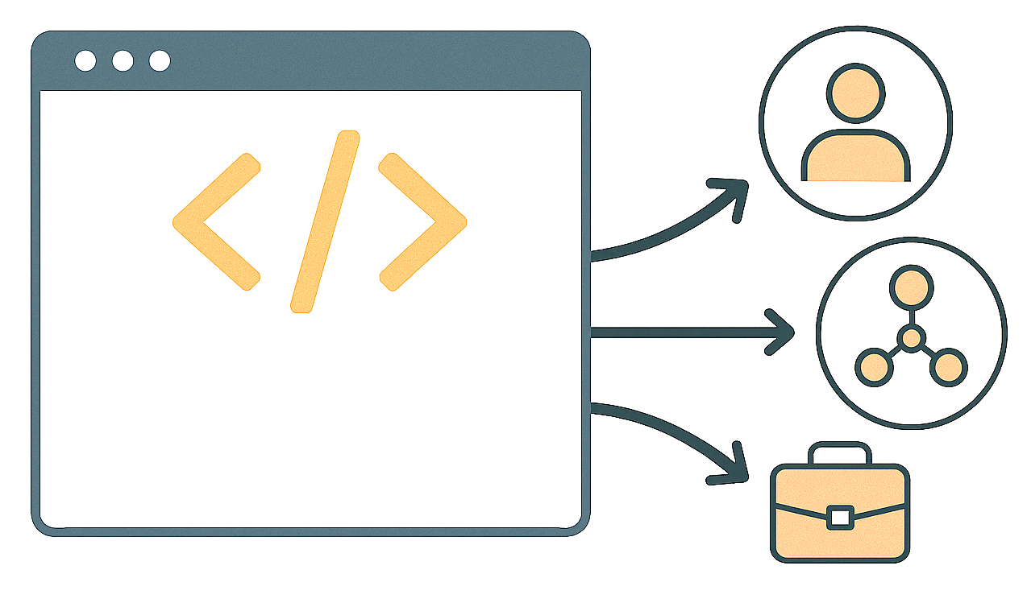
Object Oriented Programming (OOP)
An approach to code or design software by using the concepts of objects

Slide 4
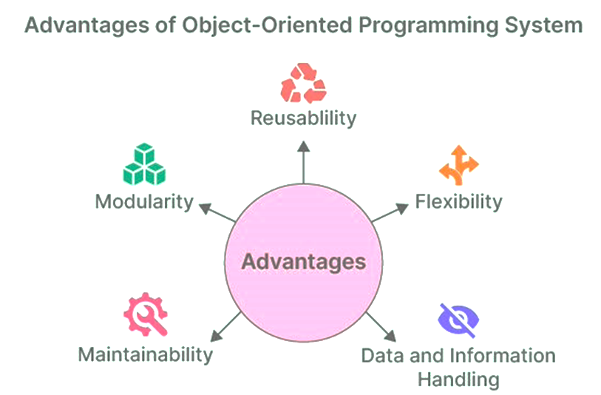
Why we need OOP

Slide 5









Objects
Objects are tangible/Non-Tangible things
Visible things that can be perceived by the senses
Specific form
Interacted with

Slide 6
Group of Objects: Class
Arrange objects into groups based on their features-

Slide 7
Objects
Objects are characterized by two components:
1) Data (also called Attributes)
2) Behaviors (also called Procedures, Methods or functions)

Slide 8
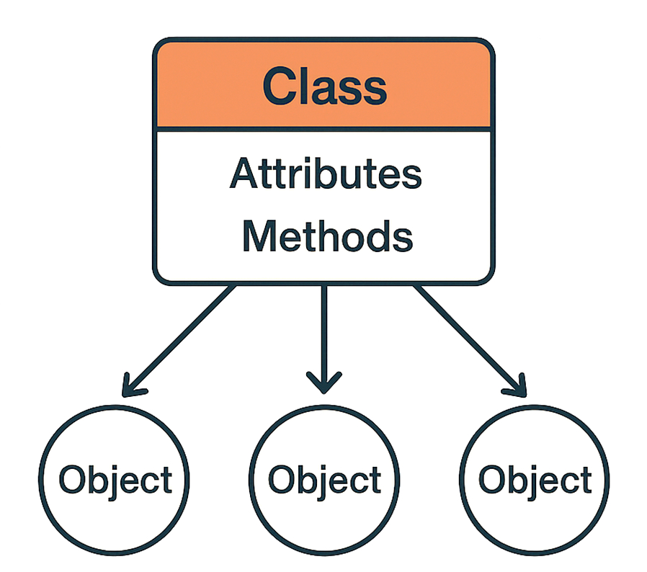
Class
A Class is a blueprint from which specific objects are created.
Classes allow you to group related data and behaviour together. This is called Encapsulation, and it offers Code Maintainability, Modularity and Reusability (because of modularity) and Security.
In other words, a class is a special data type which defines how to build a certain kind of object.
An Object is an instance of a specific Class.

Slide 9
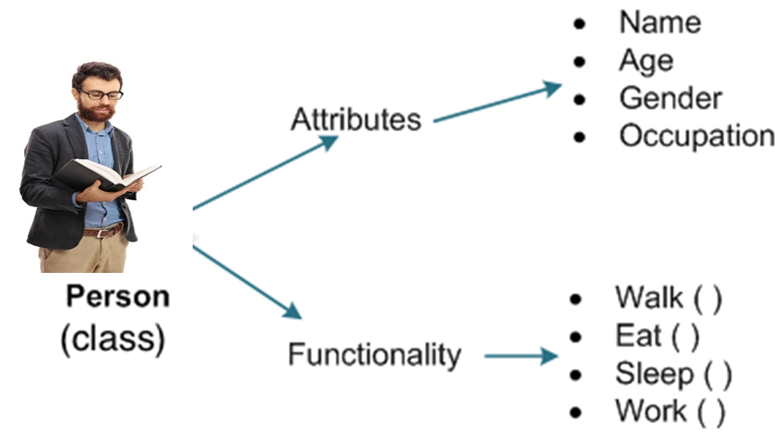
Person class

Slide 10
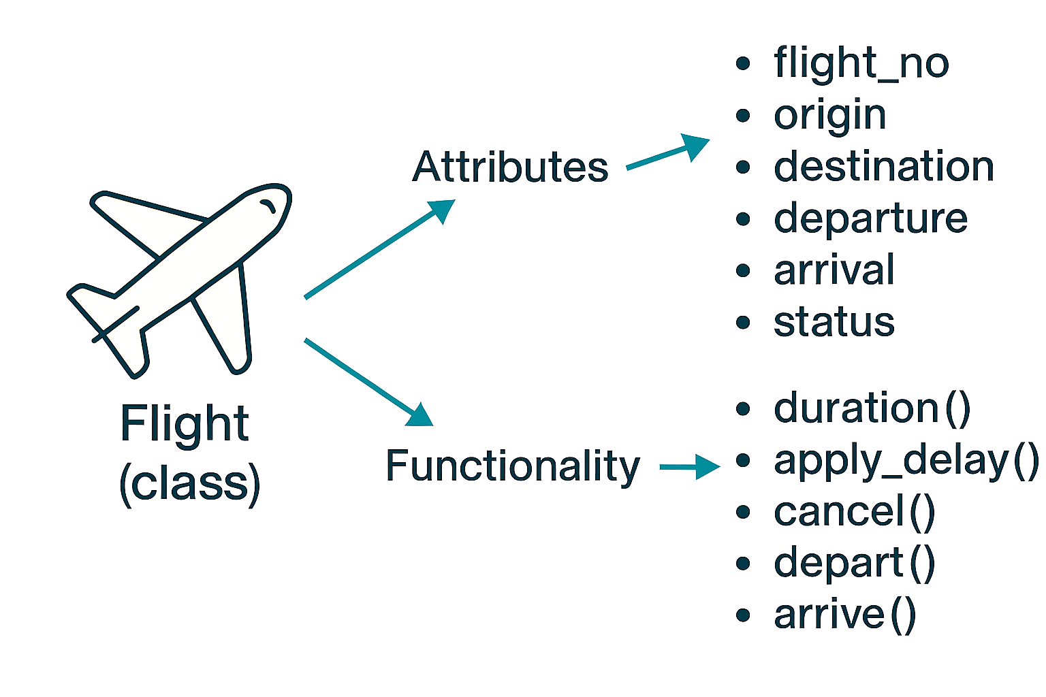
Flight class

Slide 11
Creating Class
In Python a class is defined with the class keyword, followed by an intended block
Use pass keyword to define empty class
Use pass keyword when you don’t know the attribute of class
Class <classname>:
pass
Notes:
https://python-course.eu/oop/class-instance-attributes.php

Slide 12
Creating Class
In Python a class is defined with the class keyword, followed by an intended block
Don’t use pass if you know the attribute of class
Class <classname>:
attribute=myattribute
Notes:
https://python-course.eu/oop/class-instance-attributes.php

Slide 13
Creating Person Class
Remember use class keyword to define a class
Remember don’t use pass if you know the attribute of class
Class <classname>:
attribute= myattribute
Class Person:
pass
Notes:
https://python-course.eu/oop/class-instance-attributes.php

Slide 14
Creating Person Class
Remember use class keyword to define a class
Remember don’t use pass if you know the attribute of class
Class Person:
name=“Alice”
age=30
gender=“Female”
occupation=“Nurse”
Notes:
https://python-course.eu/oop/class-instance-attributes.php

Slide 15
Using/calling person class attribute
Class Person:
name=“Alice”
age=30
gender=“Female”
occupation=“Nurse
p1=Person()
p1.name
p1.age
p1.gender
p1.occupation
Class attributes can be used by creating instance of class or object then using dot operator
Output
Alice
30
Female
Nurse
34
Notes:
https://python-course.eu/oop/class-instance-attributes.php

Slide 16
Changing value of attribute
Class Person:
name=“Alice”
age=30
gender=“Female”
occupation=“Nurse
p1=Person()
p1.name
p1.age
p1.gender
p1.ocupation
p1.age=34
p1.age
Class attributes can be used by creating instance of class or object then using dot operator
Output
Alice
30
Female
Nurse
Notes:
https://python-course.eu/oop/class-instance-attributes.php

Slide 17
Methods in a Class
Define a method in a class by including function definitions
within the scope of the class block. That means that when you are
developing a class, any function that you want to be a "method" of
that class (meaning it can be called on objects of that class) needs
to be written with an indentation level that places it inside the class’s
definition.

Slide 18
Creating functionality for the person class
Remember function/procedure/method all are different name to represent the behaviour of class
def keyword for defining method
Class Person:
name=“Alice”
age=30
gender=“Female”
occupation=“Nurse”
def <method_name>():
.
.
Notes:
https://python-course.eu/oop/class-instance-attributes.php

Slide 19
Creating functionality for the person class
Class Person:
name=“Alice”
age=30
gender=“Female”
occupation=“Nurse”
def walk(self):
pass
def eat(self):
pass
def sleep(self):
pass
def work(self):
pass
Remember function/procedure/method all are different name to represent the behaviour of class
def keyword for defining method
Use pass keyword when you don’t know the attribute of class
Notes:
https://python-course.eu/oop/class-instance-attributes.php

Slide 20
Creating functionality for the person class
Class Person:
name=“Alice”
age=30
gender=“Female”
occupation=“Nurse”
def walk(self):
pass
def eat(self):
pass
def sleep(self):
pass
def work(self):
pass
self is not keyword
In class methods first parameter is always self
self is accessing attribute
any other word can be used instead of self
Notes:
https://python-course.eu/oop/class-instance-attributes.php

Slide 21
Using person class methods
Class Person:
name=“Alice”
age=30
gender=“Female”
occupation=“Nurse”
def walk(self):
print(‘walk method’)
def eat(self):
print(‘eat method’)
def sleep(self):
pass
def work(self):
pass
p1=Person()
p1.name
p1.age
p1.gender
p1.occupation
p1.walk()
p1.eat()
Class methods can be used by creating instance of class or object then using dot operator
Output
Alice
30
Female
Nurse
walk method
eat method
Notes:
https://python-course.eu/oop/class-instance-attributes.php

Slide 22
Creating Flight Class
Create Flight class and add attributes and functionality
Class activity
Notes:
https://python-course.eu/oop/class-instance-attributes.php

Slide 23

Any Questions

